Slide 1


Default of Credit Card Clients
Hetarth Bhatt – 251056818
Khushali Patel – 25105445
Rajaraman Ganesan – 251056279
Vatsal Shah – 251041322

Slide 2
AGENDA
Problem Overview
Why is it important?
Numbers
Dataset overview
Data preparation
Proposed models
Evaluation - Accuracy and Comparison
Conclusion
References

Slide 3
Problem Overview – ‘WHY’?
? How many are using Credit Card Everyday?
? Do you know the process of each credit card transaction?
? Do you know the actual picture and process behind the credit card process?
Yes, We are not going to give you the software process but will show you some numbers and importance of it.
Excited?

Slide 4
Overview
Banking/Financial Institutes plays a significant role in providing financial service
To maintain the integrity, bank/institute must be careful when investing in customers to avoid financial loss.
Before giving credit to borrowers, the bank must come to about the potential of customers
The term credit scoring, determines the relation between defaulters and loan characteristics.
GOAL:
The model we built here will use all possible factors to predict data on customers to find who are defaulters and non-defaulters next month.
The goal is to find the whether the clients are able to pay their next month credit amount

Slide 6
Process – supervised / why / approach design /
BACKGROUND APPROACH
For financial institutions, identifying defaulters play a vital role during issue of credit cards.
In order to overcome the issue banks need to screen the information of every client
Preparation of data
Applying models
Comparing the models applied
Calculation of Accuracy
Analyse the best model

Slide 7
Credit Card Dataset
Oriented: UCI Machine Learning Repository. (Link)
Attributes: 24
Records: 30,000
The attributes:
The customer has made their next payment or not
ID of customer
Credit limit
Gender
Age
Marital status
Level of education
History of their past payments made (time)
Amount of bill statement
Amount of previous payment.
Link: (https://archive.ics.uci.edu/ml/datasets/default+of+credit+card+clients)

Slide 8
Preprocessing
Dataset has categorical variables like
Education
Gender
Marital status - which are converted to dummy variable to fit into model using one hot encoding
EDUCATION | ENCODING | GENDER | ENCODING | MARITAL STATUS | ENCODING
Grad School | 1 | Male | 1 | Married | 1
University | 2 | Female | 2 | Single | 2
High School | 3 |  |  | Others | 3
Others | 4

Slide 10
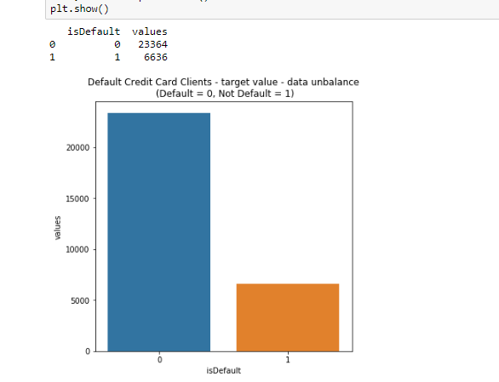
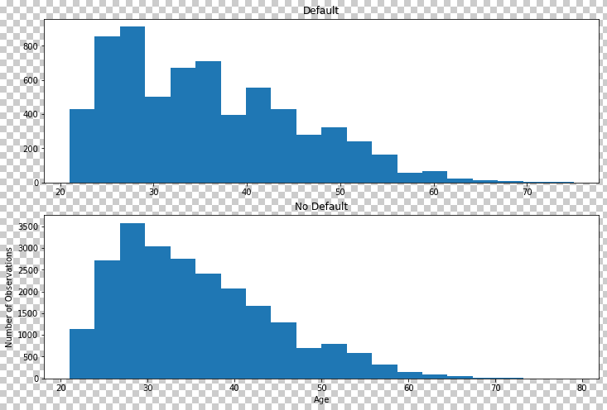
Dataset Understanding

Slide 11
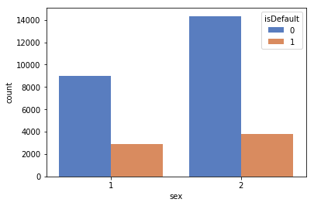
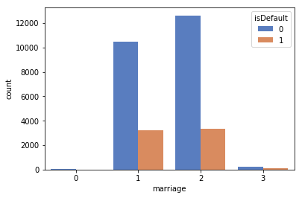
Dataset understanding

Slide 12
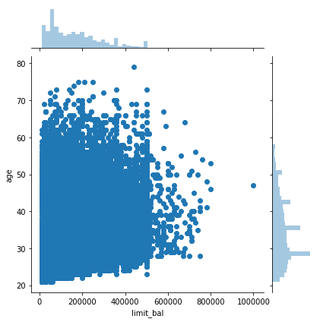
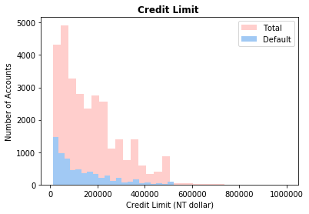
Credit Limit

Slide 13
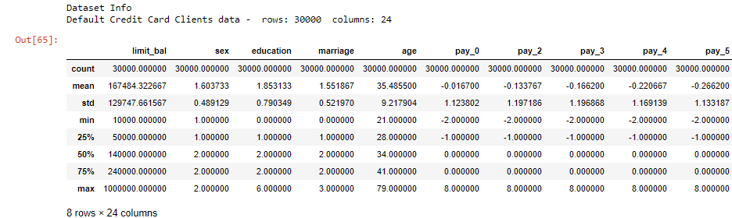
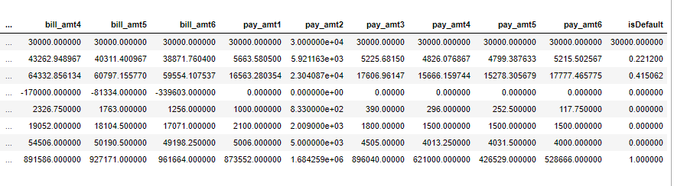
Importance of features

Slide 14
Proposed Models
Predict the client
can make his/her next payment
OBJECTIVE
Observations, base rate.
K-fold cross validation applied
NOTES – evalu//
Logistic Regression
SVM
KNN
?
?
Neural Networks
ALGORITHMS USED

Slide 15
Proposed Models
LOGISTIC REGRESSION:
A statistical method for analyzing a dataset in which there are one or more independent variables that determine an outcome.
Goal is to find the best fitting model to describe the relationship between the dichotomous characteristic of interest and a set of independent variables.
SUPPORT VECTOR MACHINE:
Support vector machine classifier is one of the most popular machine learning classification algorithm.
It is used as supervised learning when dataset have features and class labels.
K-NEAREST NEIGHBOUR:
K-nearest neighbor(KNN) is one of the simplest supervised classifier and it is used to predict the target label by finding the nearest neighbor class.
The main idea is to define K centroids, one for each cluster.
When given an unknown data, the KNN classifier searches the pattern space for the KNN which are the closest to this unknown data. This closeness is defined by distance.

Slide 16
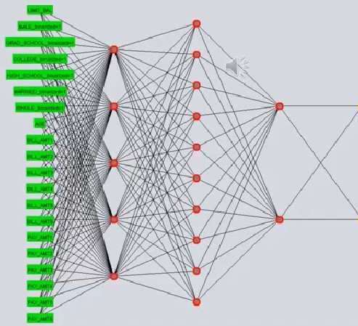
NEURAL NETWORKS

Slide 17
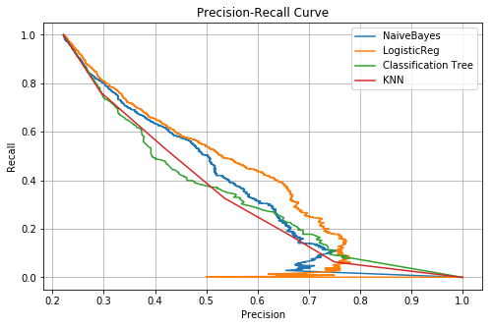
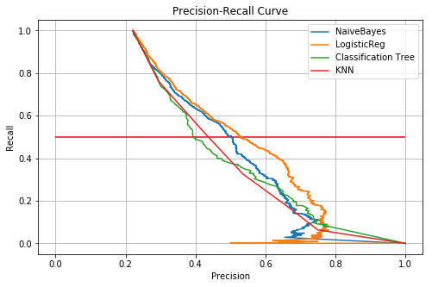
Evaluation

Slide 18
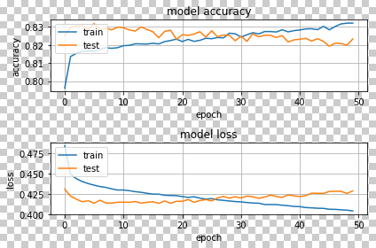
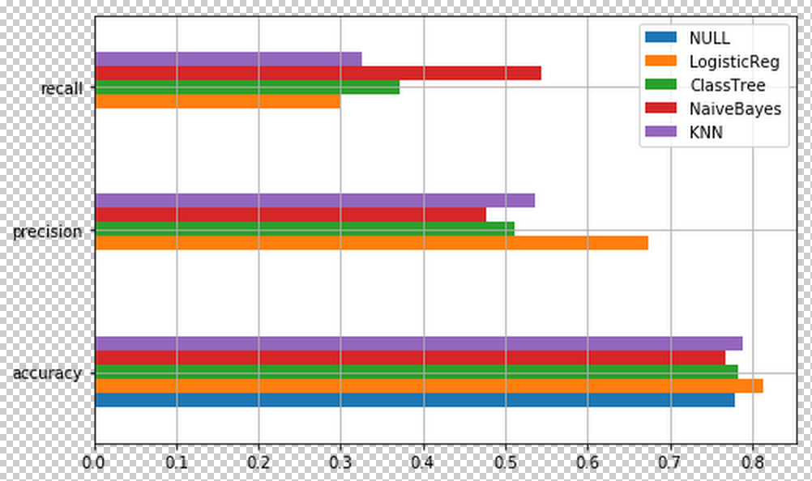
Tuning parameters

Slide 19
Conclusion
SVM has highest accuracy compared to xx.

Slide 20
Not FINAL CONCLUSION!!!

Slide 21
FINAL Conclusion
Applied algorithms comparison

Slide 22
Demo

Slide 23
references
Li, Xiao-Lin, and Yu Zhong. An overview of personal credit scoring: techniques and future work. Journal: International Journal of Intelligence Science ISSN 2163-0283. 2012.
Federal Reserve. (2017) “Report to the Congress on the Profitability of Credit Card Operations of Depository Institutions”. Available
Taiwo Oladipupo Ayodele. (2010) “Types of Machine Learning Algorithms”, New Advances In Machine Learning, Yagang Zhang (Ed.), Intech

Slide 24
THANK YOU

Slide 25
QR Code
Scan QR code and access Report and PPT

